Slide 1
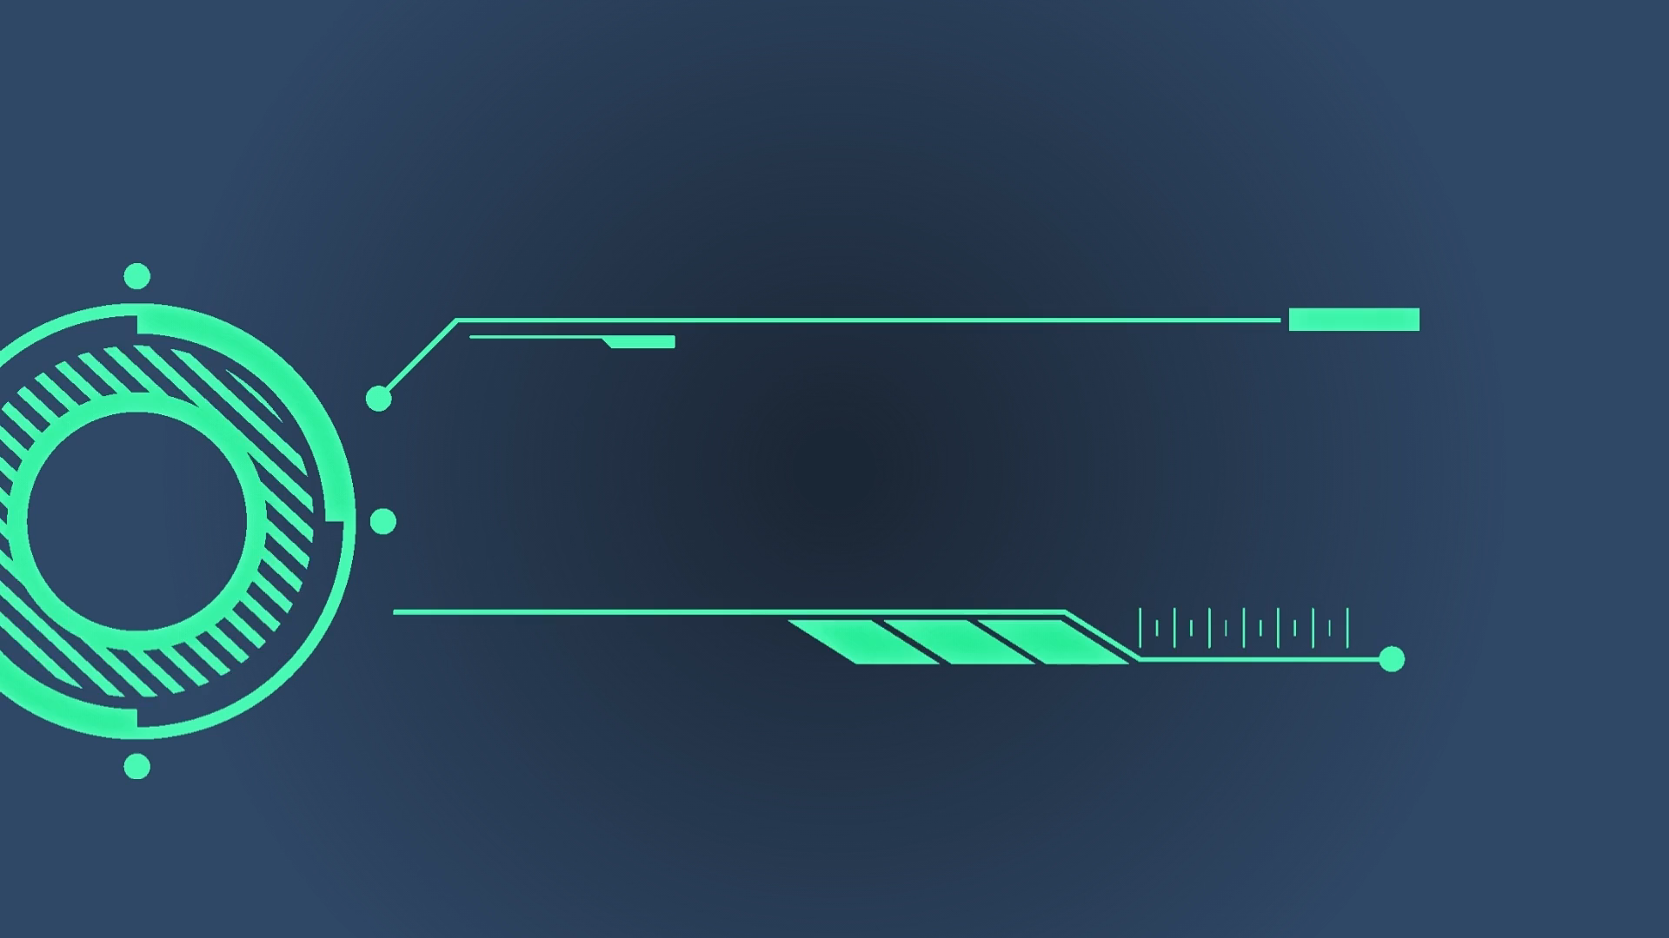

Slide 2
Tech Byte Security Management

Slide 3
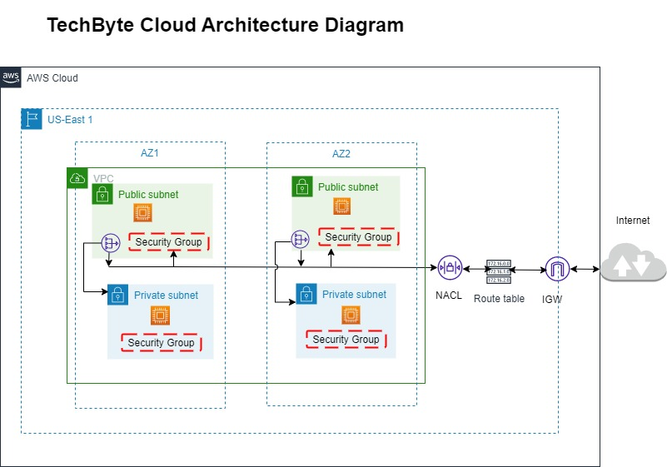
Tech Byte Architecture Diagram

Slide 4
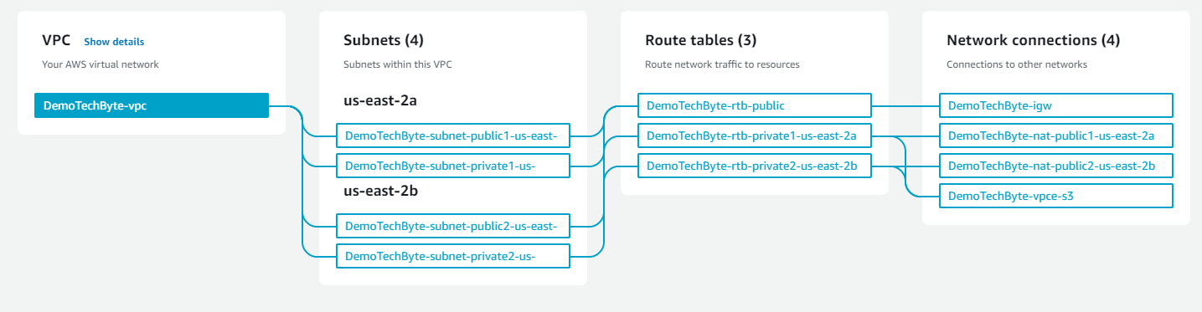
Network configuration

Slide 5
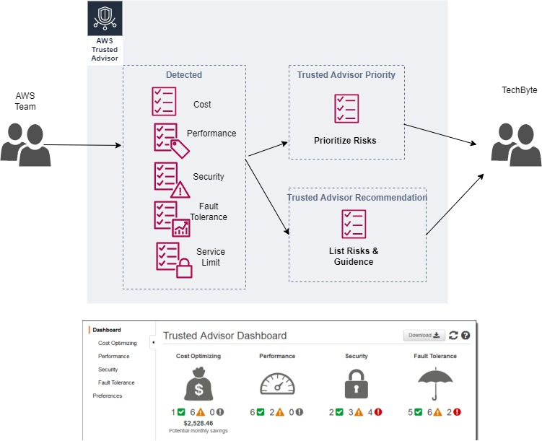
Trusted Advisor Recommendations

Slide 6
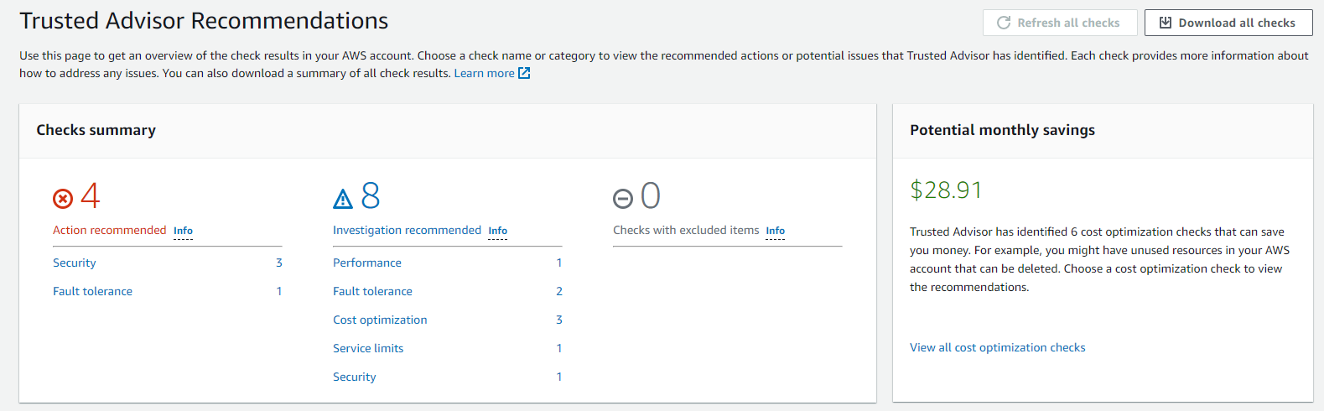
Trusted Advisor

Slide 7
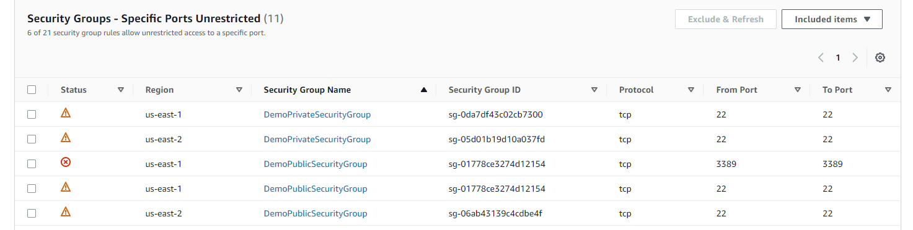


Security Insights

Slide 8
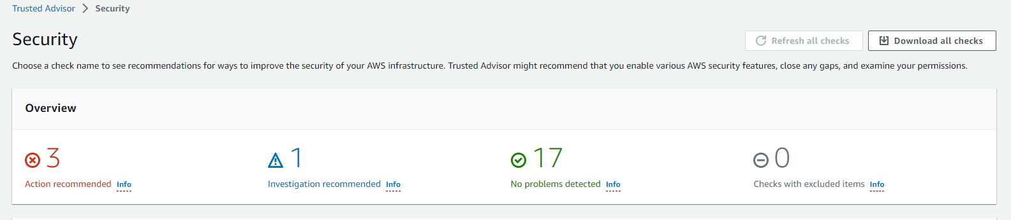
Remediation

Slide 9
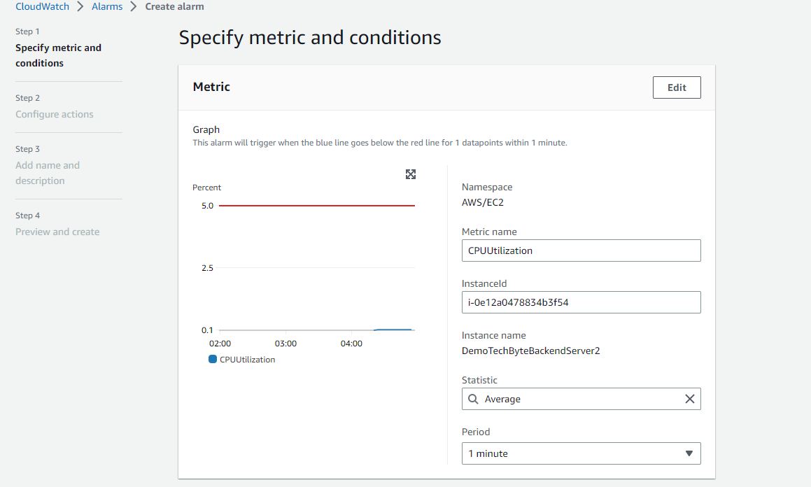
Cost Optimization EC2

Slide 10
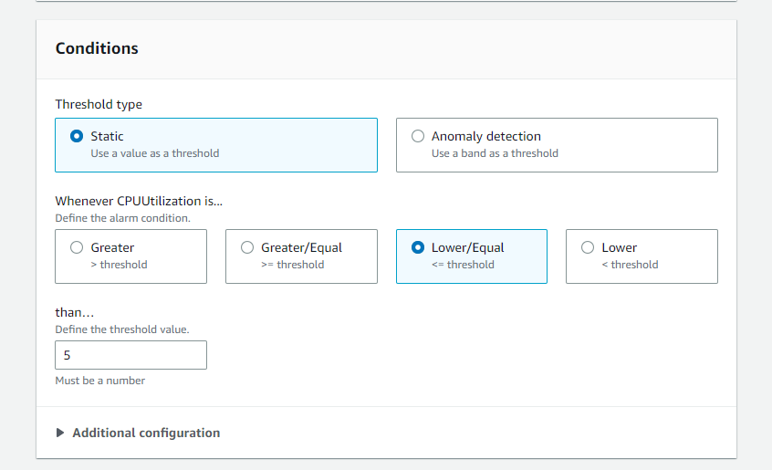
Cloud Watch Alarm

Slide 11
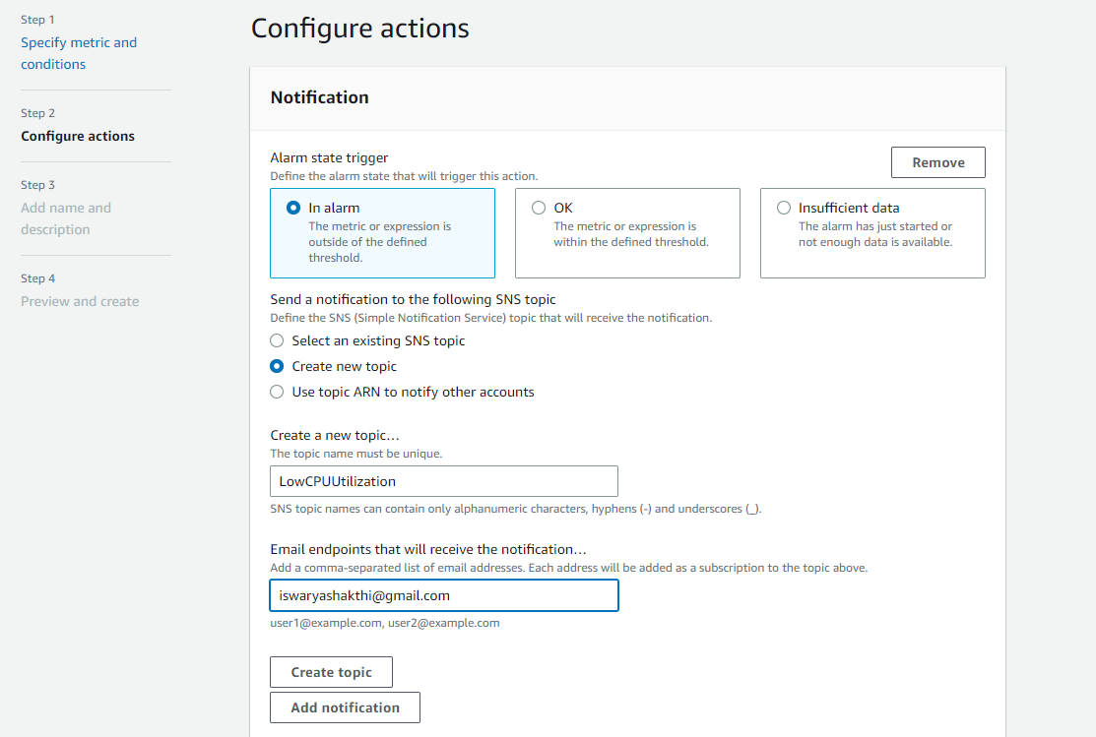
Cloud Watch Alarm

Slide 12
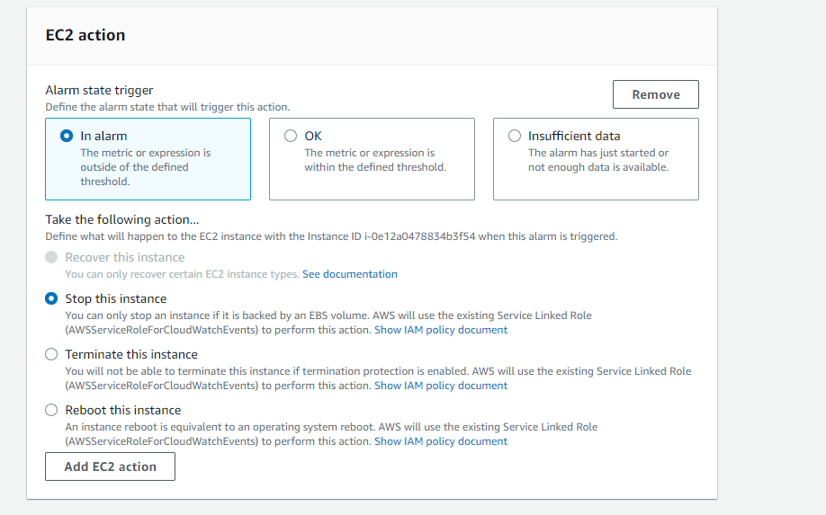

Cloud Watch Alarm

Slide 13
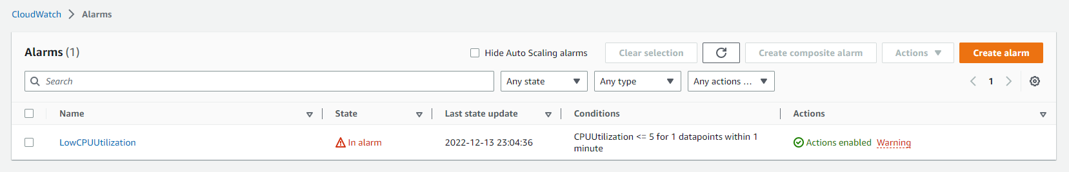
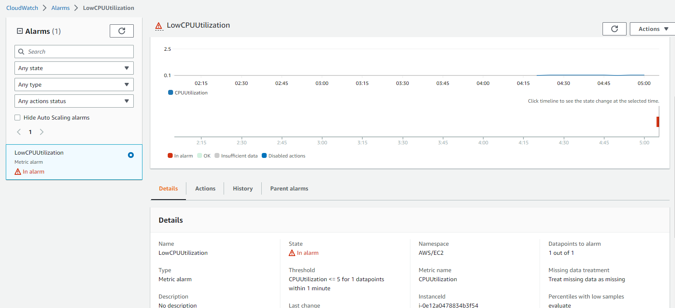


Cloud Watch Alarm

Slide 14
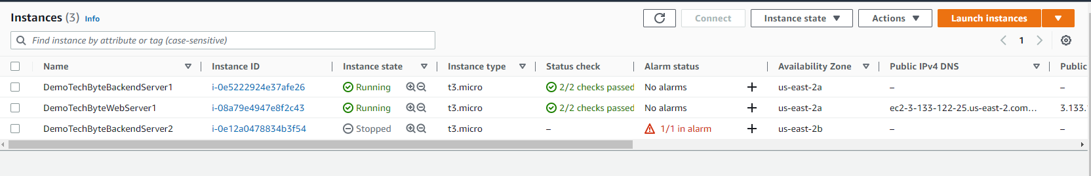
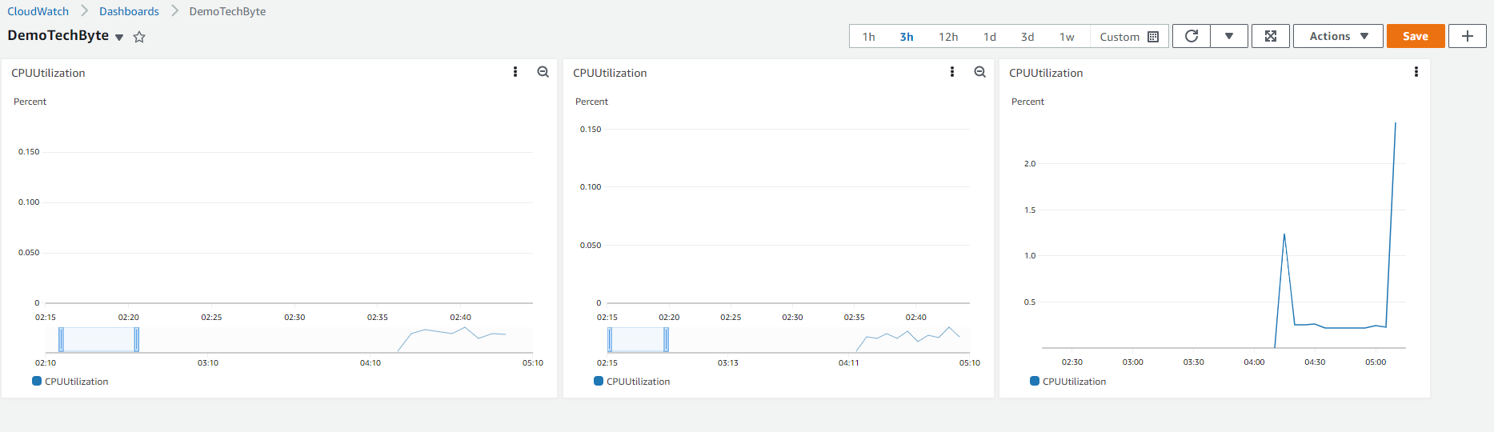


Cloud Watch Alarm

Slide 15
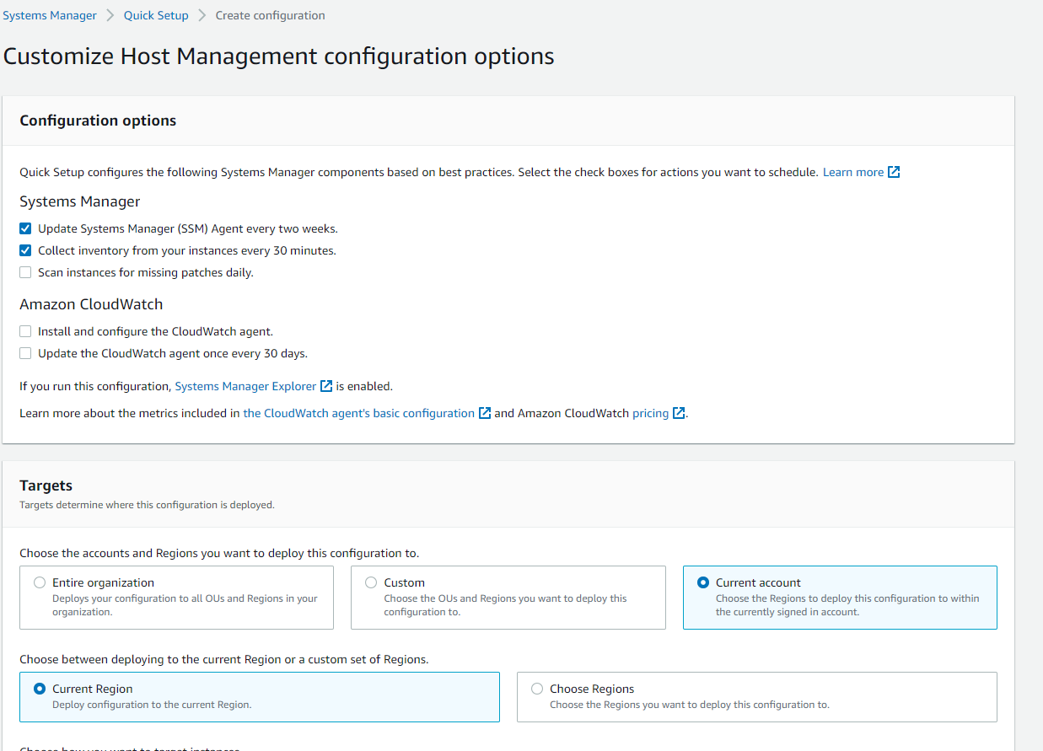
Patch Management

Slide 16
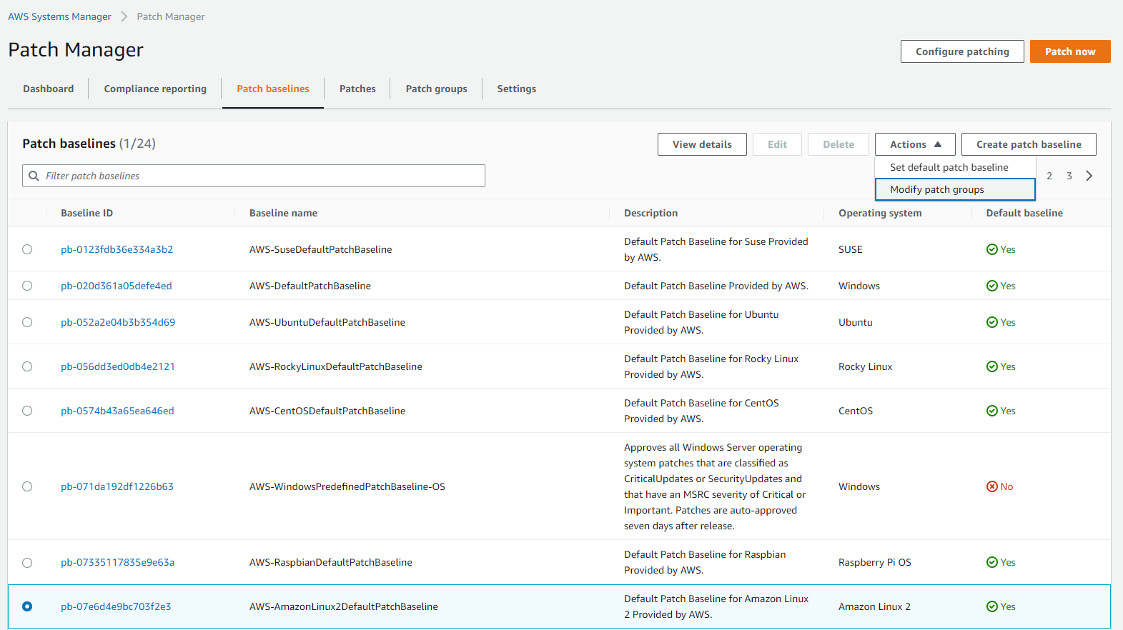
Patch manager configuration

Slide 17
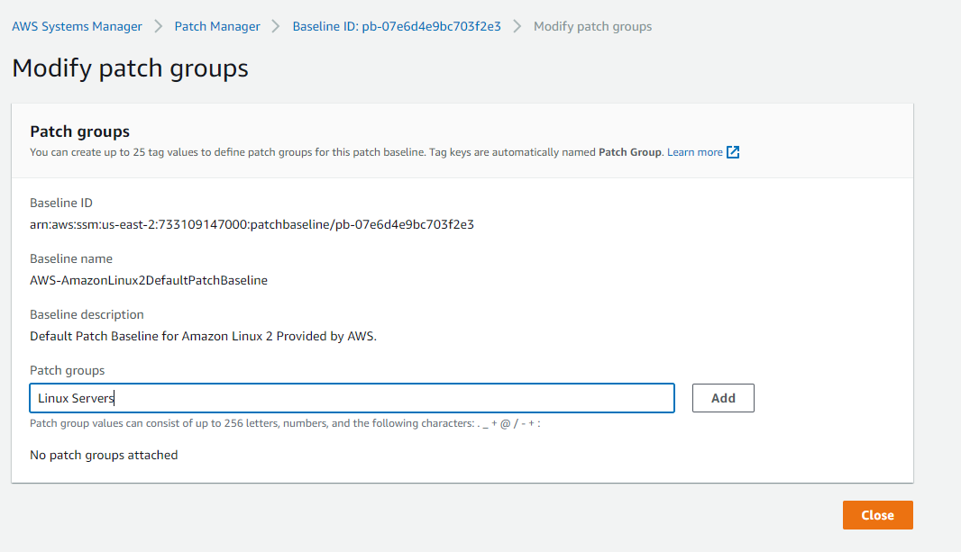
Patch manager configuration

Slide 18
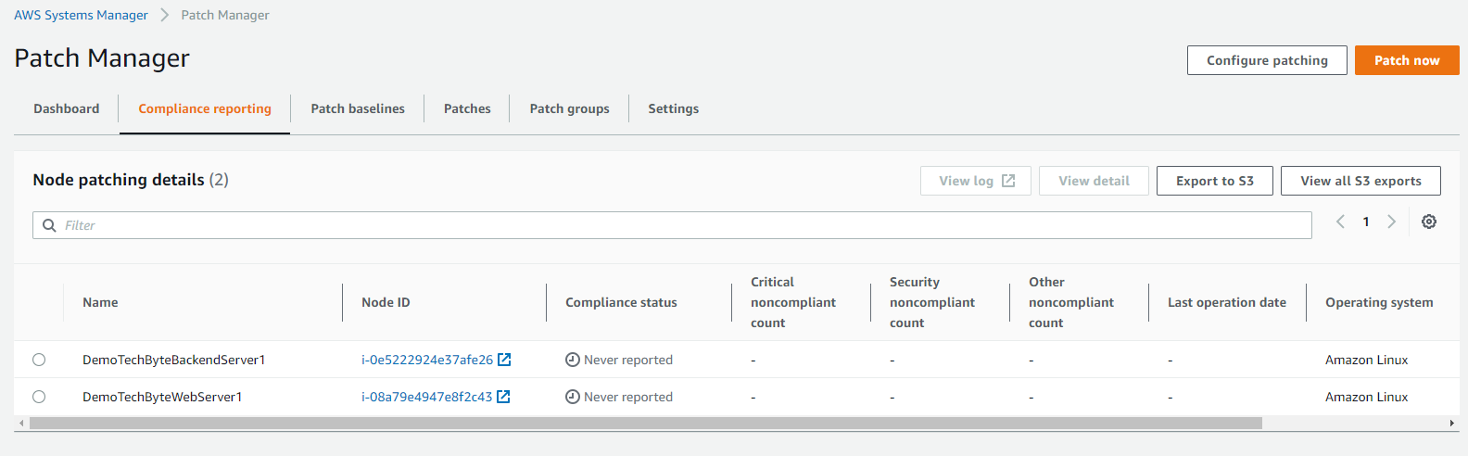
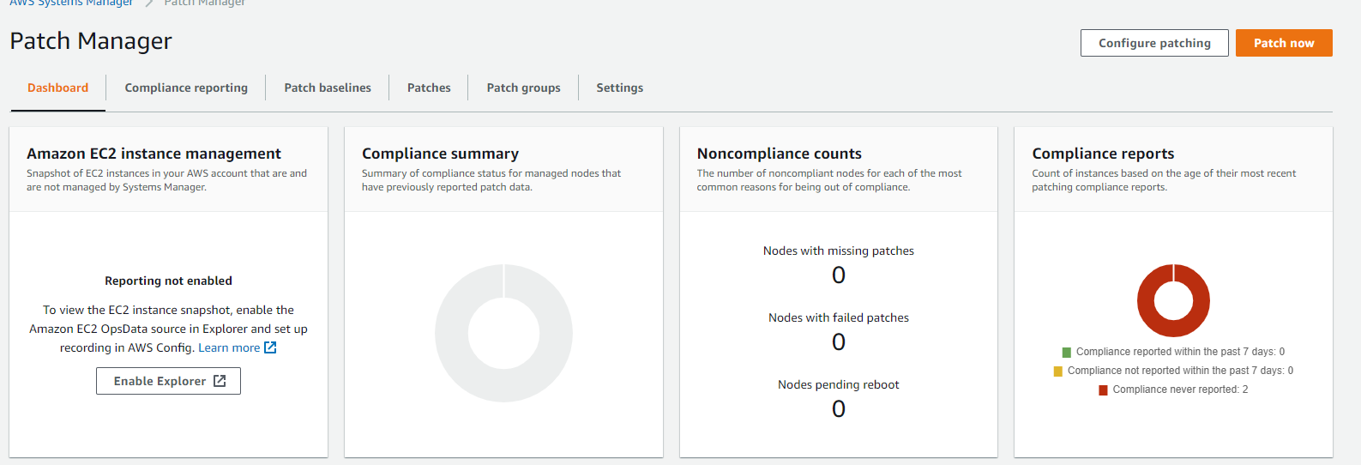



Patch manager configuration

Slide 19
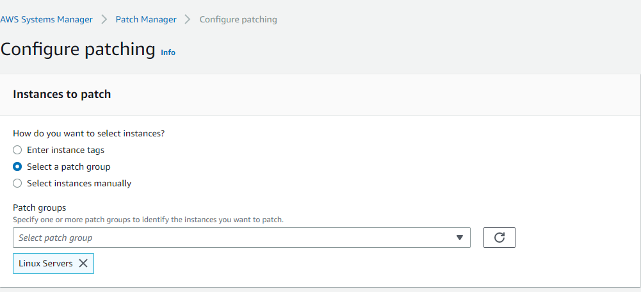
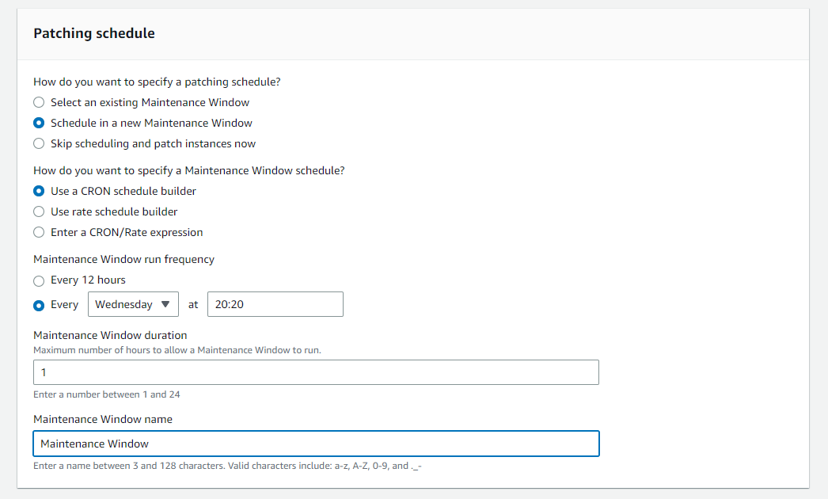
Patch manager configuration

Slide 20
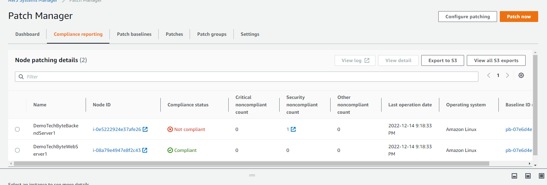
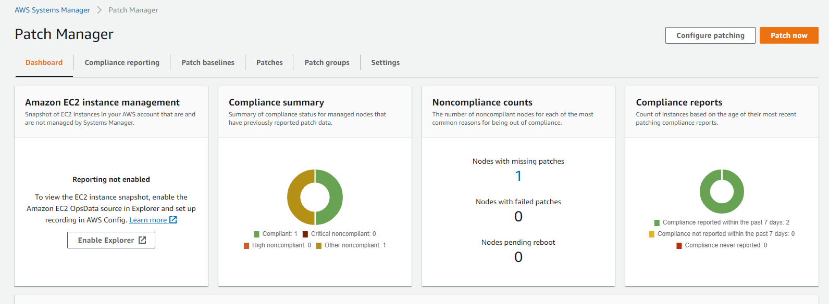


Patch manager configuration

Slide 21
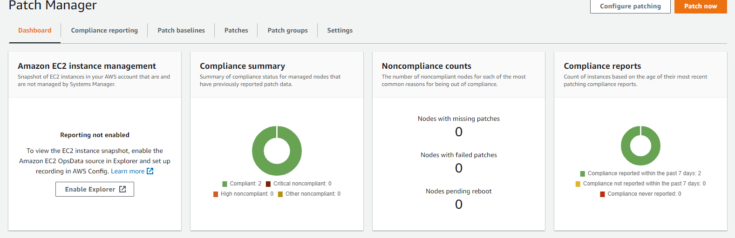
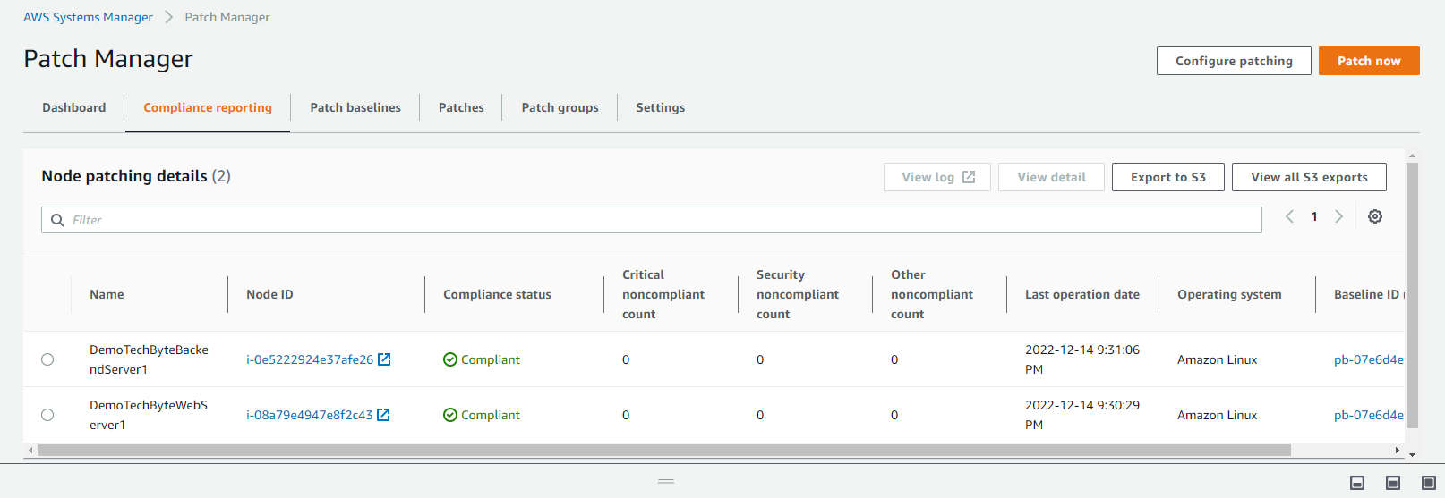



Patch manager configuration

Slide 22
Recommendation
Fault Tolerance and Performance
With two or more AZs, TechByte can introduce ELB to distribute the load and avoid downtime. This way we could provide fault tolerance as well as improved performance.
Service limits
Proactively check service limits from Trusted Advisor and increase limits for appropriate AWS services to avoid interruption.

